Slide 1







Slide 2
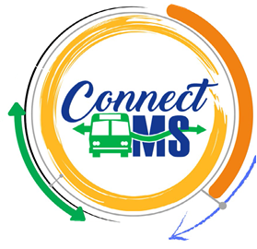
Community Transit
In
Mississippi
“Access to Mobility Impacts the Quality of Life”
MS Housing Conference
April 29 - May 1, 2026

Slide 3

MDOT Public Transit Division – What We Do
The Division administer federal and state grant programs and provides technical assistance to state agencies, local governments, as well as public and private non-profit sponsors of transportation programs or projects to develop and maintain coordinated, affordable and accessible mobility options. The Division plan, develop, support and oversee the delivery of a comprehensive transit network with emphasis on accessing services that improve quality of life opportunities.

Slide 4
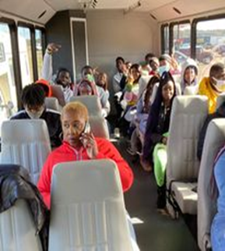
Program Descriptions
5310 Enhanced Mobility of Seniors and Individuals with Disabilities
The goal of the Section 5310 program is to enhance mobility for seniors & persons with disabilities by providing funds for programs to serve the special needs of transit-dependent populations beyond traditional public transportation services & Americans with Disabilities Act complimentary para-transit services
5311 Rural Areas Programs
To provide capital, planning, and operating assistance to states to support public transportation including Job Access and Reverse Commute in rural areas with population less than 50,000, where many residents often rely on public transit to reach their destinations.

Slide 5
COMMUNITY TRANSIT IN MISSISSIPPI
Coordination and collaboration are essential for access to Mobility
Connecting communities as a whole is the goal
Public, Private and specialized transportation providers make up the “Community Transit” network

Slide 6
STATEWIDE/REGIONAL COORDINATION
Coordination is how we plan and provide services.
Overall goal is to improve availability and accessibility of resources.
Essential strategic actions include:
  Increased investments
  better use of resources
  more flexibility ; and
  More partnerships with the public/private sector
A bottom-up collaborative planning process identified as most practical way to stretch resources and improve mobility for everyone.

Slide 7

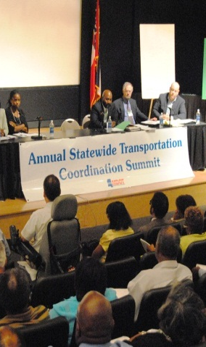
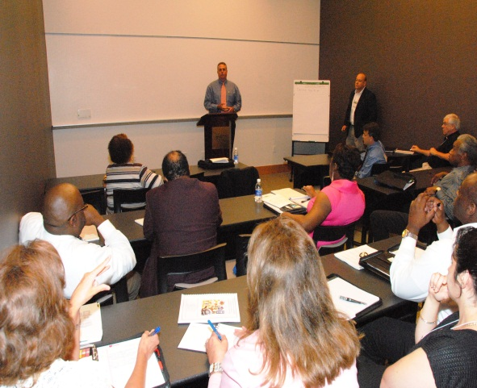
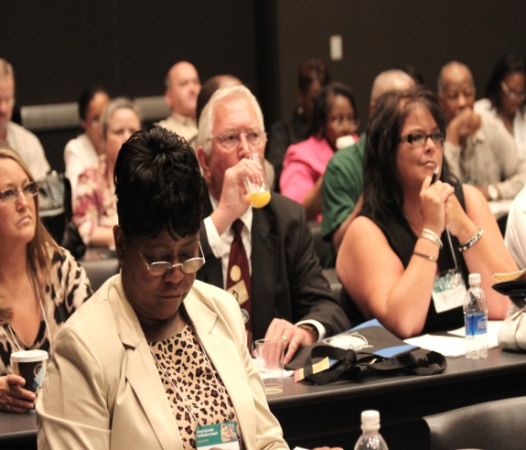
Coordination
A “Process” through which stakeholders from different agencies, organizations and client groups work together to achieve one or all of the following goals:
    More efficient service delivery
    More cost-effective service delivery
    Increased mobility options
    Easier service access
    A better quality of life

Slide 8
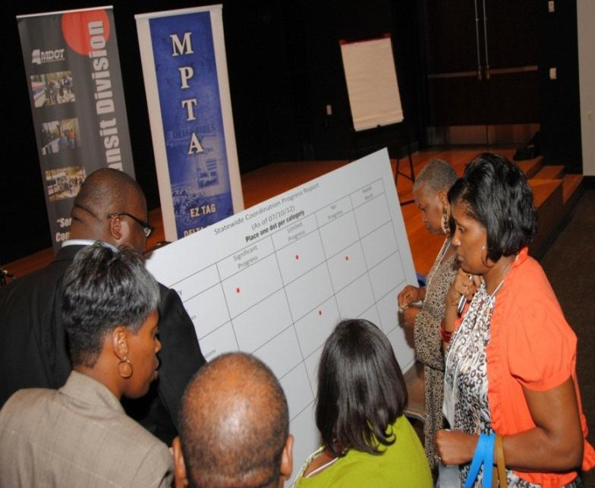
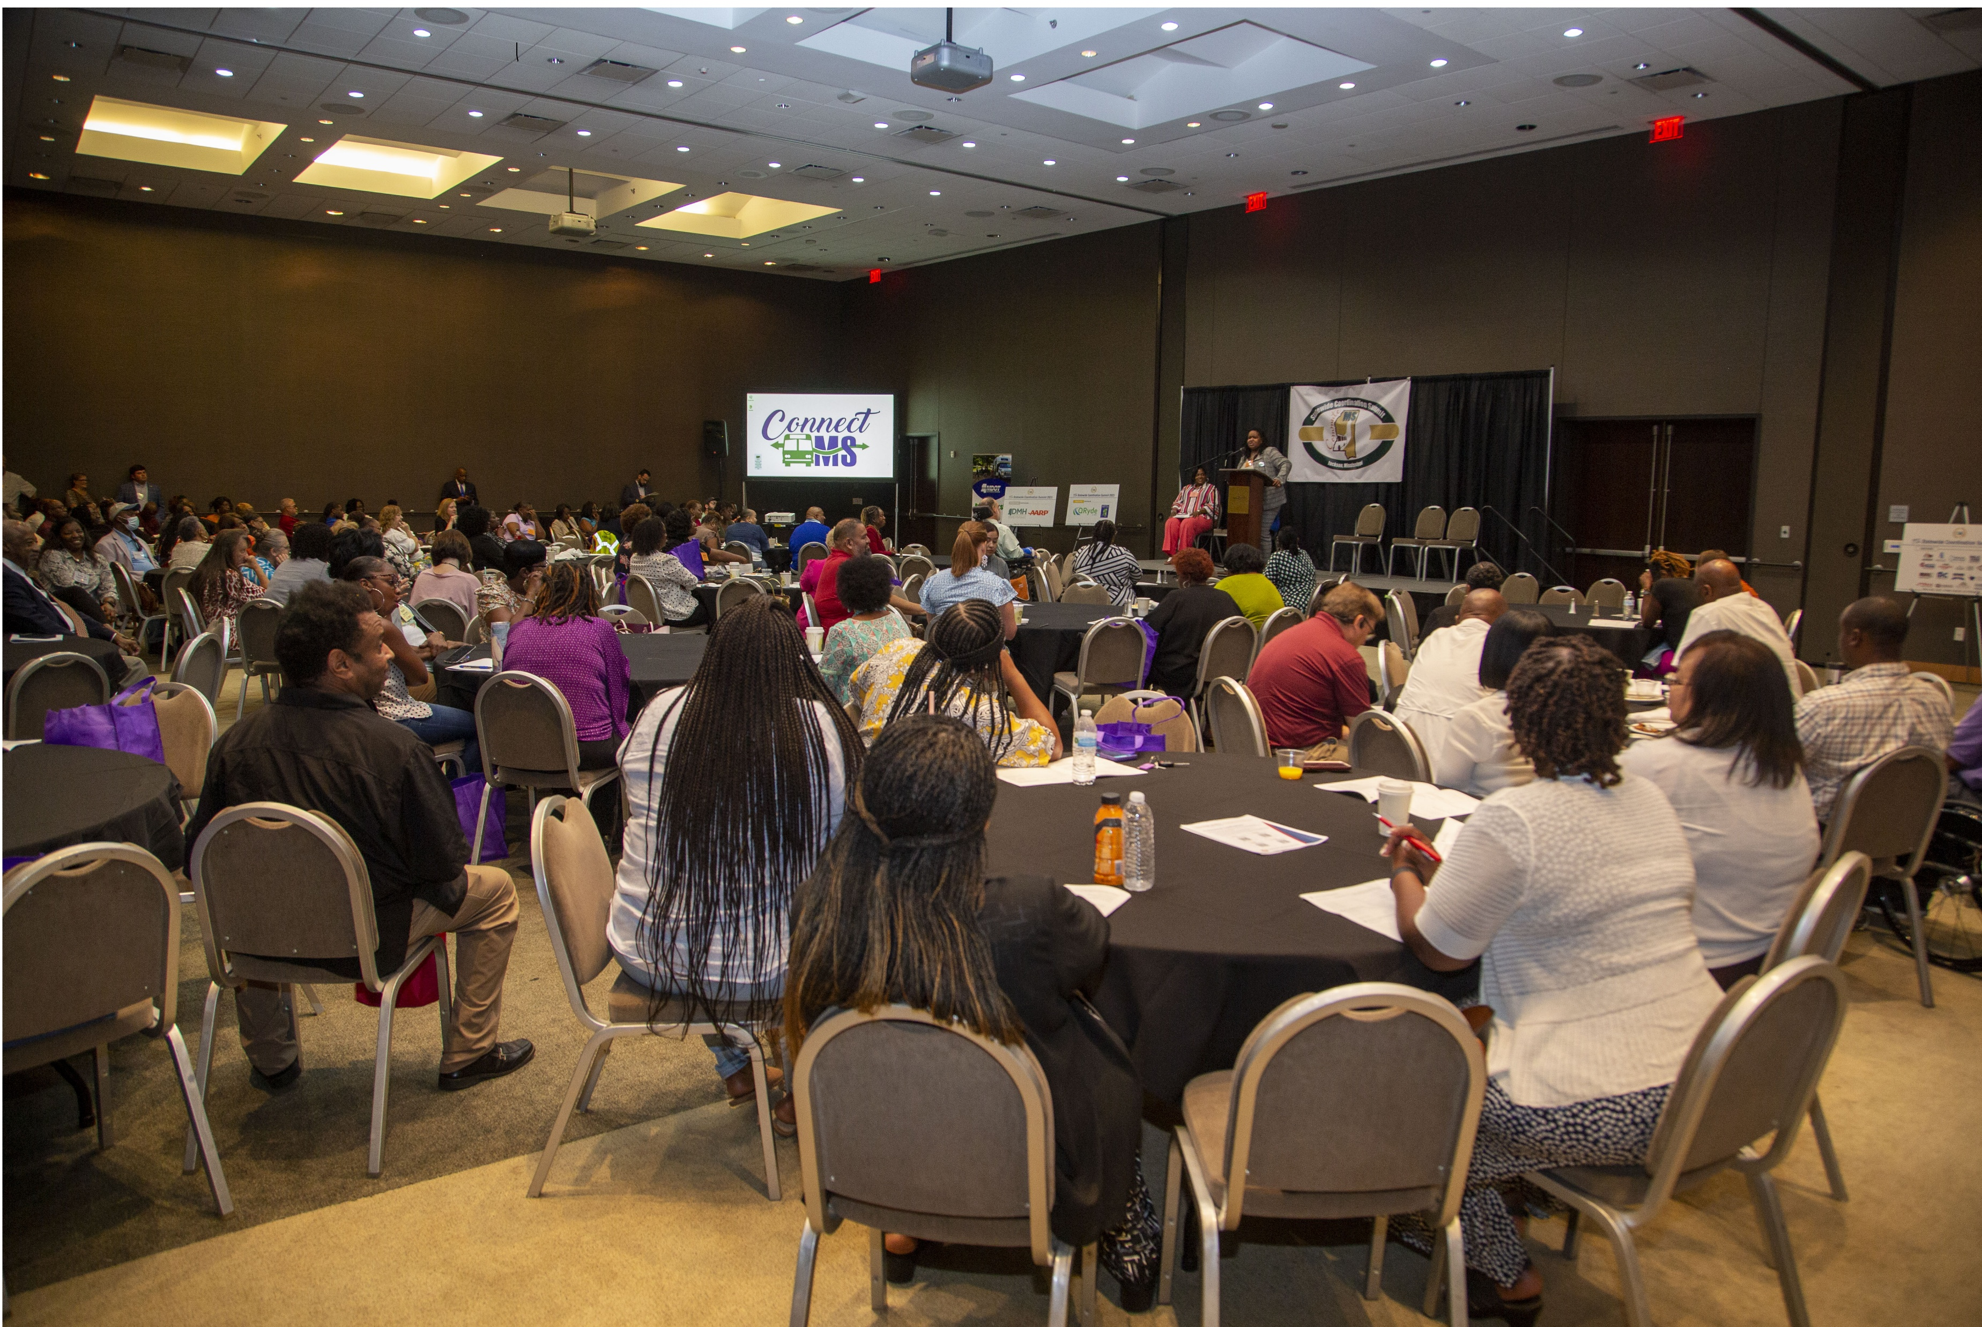
Statewide/Regional Coordination Approach
Local coordinated planning….spearheaded via six regional groups is a critical step of the broader collaborative progress.
Throughout the State, groups of stakeholders are developing solutions to mobility issues.
Regional coordination is the keystone concept for developing innovative service arrangements

Slide 9
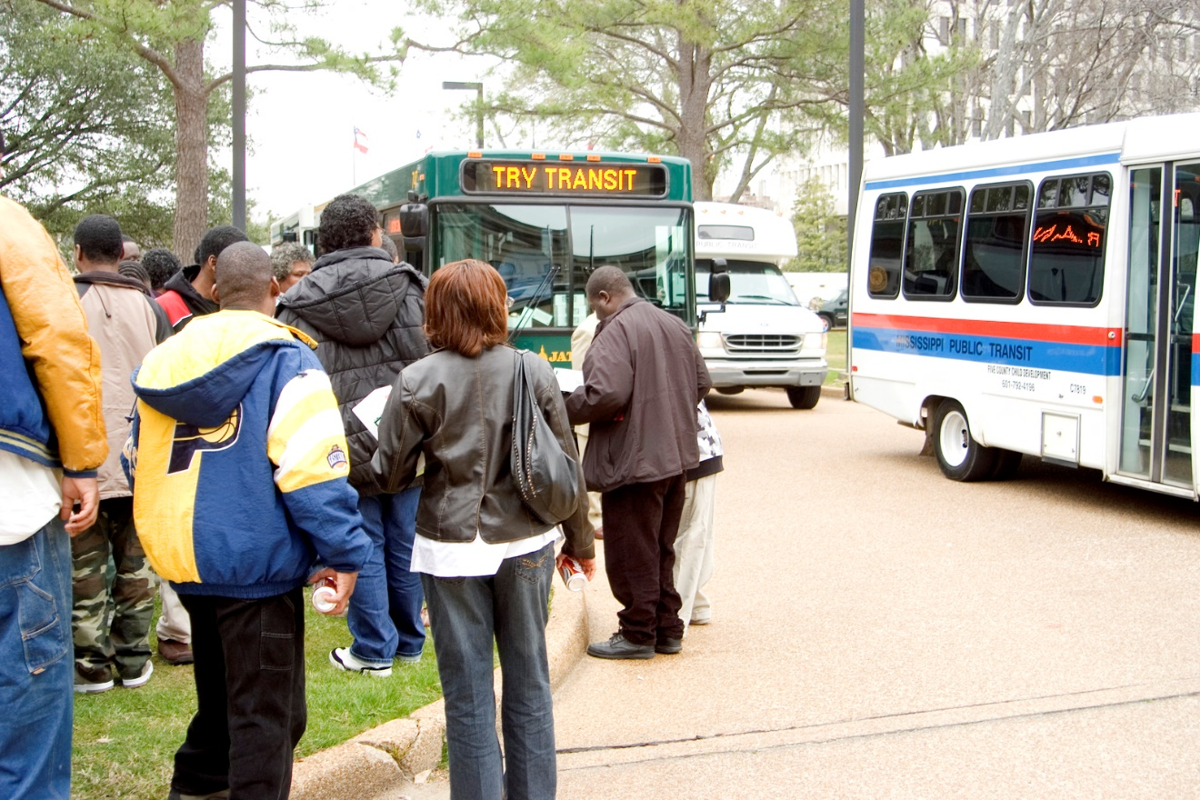
Benefits of Community Transit
Building and maintaining transportation infrastructure in urban and rural areas is imperative to meeting the need for access to jobs, shopping, government services, housing, education, and healthcare within small cities, towns, and their surrounding communities.
Provide better mobility for individuals and targeted groups (e.g. low income, seniors, persons with disabilities or veterans)
Generate jobs, enhance economic growth and support the implementation of public policies relating to areas such as health care, criminal justice recidivism as well as job development and training
Access and mobility are important to developing more vibrant and livable communities across the State.
With the increased emphasis on workforce development efforts (especially job development, training) transit projects have made much success in partnering with employers for trips to employment destination within the state.
Environment conservation – reduction of gas emission- less vehicles on the roads

Slide 10
Delta Rides – Doris Green, Calvin Glover
662-846-6161, 662-302-8841
EZTAG – Lacy Funderburg, Jessica Martinez
662-325-0407
Office- 601-650-7429 /601-650-7372 Work cell-601-504-4069
NITA – Eric Jefferies
662-234-3540 Cell: 662-816-5209
SMART – Konchetta Barnes, Quenissa Fells, Tamika Scott
601-792-4196, 601-437-3063, 601-455-7568
Southern Connect – Donna Bailey
601-682-0701
TRANSCON – Atesa McKinney
601-665-2966

Slide 11






Six Regional Groups

Slide 12

Thank you!
MS Department of Transportation
P.O. Box 1850
Jackson, MS 39215-1850
601-359-7800
Shirley Wilson, Public Transit Director
e-mail: swilson@mdot.ms.gov
Roderick Bailey, Deputy Director
e-mail: rbailey@mdot.ms.gov

Slide 13
Mount Zion Economic Community Center Inc.
DBA
Community Transportation

Slide 14
Background Information
Community Transportation launch in October 2018
Community Transportation theme is “We Drive You Ride”
Community Transportation is running two bus passenger vans on routes throughout the city limits of McComb, MS and Summit, MS and Downtown Magnolia, MS
Community Transportation operates Monday through Friday from 7:00 AM to 4:00 PM
For rides you can reach dispatchers at 601.249.1999 OR 1.833.866.7433

Slide 15
Goals and Objectives
Our goal is to provide each and every rider with a safe and efficient way to and from their destinations
To allow riders to feel as independent as possible
To get people to the places they need to be

Slide 16
FARES
Rides from bus stop to bus stop in the city limits of McComb are $2.00 per ride
Rides from bus stop to bus stop in the city limits of Summit are $2.00 per ride
Rides from Summit to McComb city limit or vice versa are $3.00 per ride
Rides from McComb to Magnolia are $5.00 per ride
With low fares we allow the customers to ride to and from designated places, spend money on necessities, and still have change in the pocket afterwards!!!

Slide 17
Where can you find the bus stops?
There are bus stops placed in areas to accommodate all genres of riders
Several stops are placed in low income housing areas
Over the few years ridership numbers show that people in housing authority places have utilized our services the most
Ridership in housing authority places has an increase of 35 – 46% yearly

Slide 18
Who and Where
We offer transportation services to both ambulatory and paralift (wheelchair, motorized chair) riders
Where can you be taken to?
  Grocery stores
  Shopping malls
  Doctor Appointments
  Employment
  School
  Social clubs

Slide 19
Recap
Mount Zion Economic Community Center, Inc. dba Community Transportation
If you know someone in the Pike County area that may be in need of transportation services give us a call
We are available Monday through Friday from 7:00 Am to 4:00 PM
We provide safe, efficient, prompt transportation services to the general public

Slide 20
We can all make a difference in the lives of others in need because it is the most simple of gestures that make the most significant of differences.

Slide 21
Mount Zion Economic Community Center Inc.
DBA
Community Transportation

Slide 22
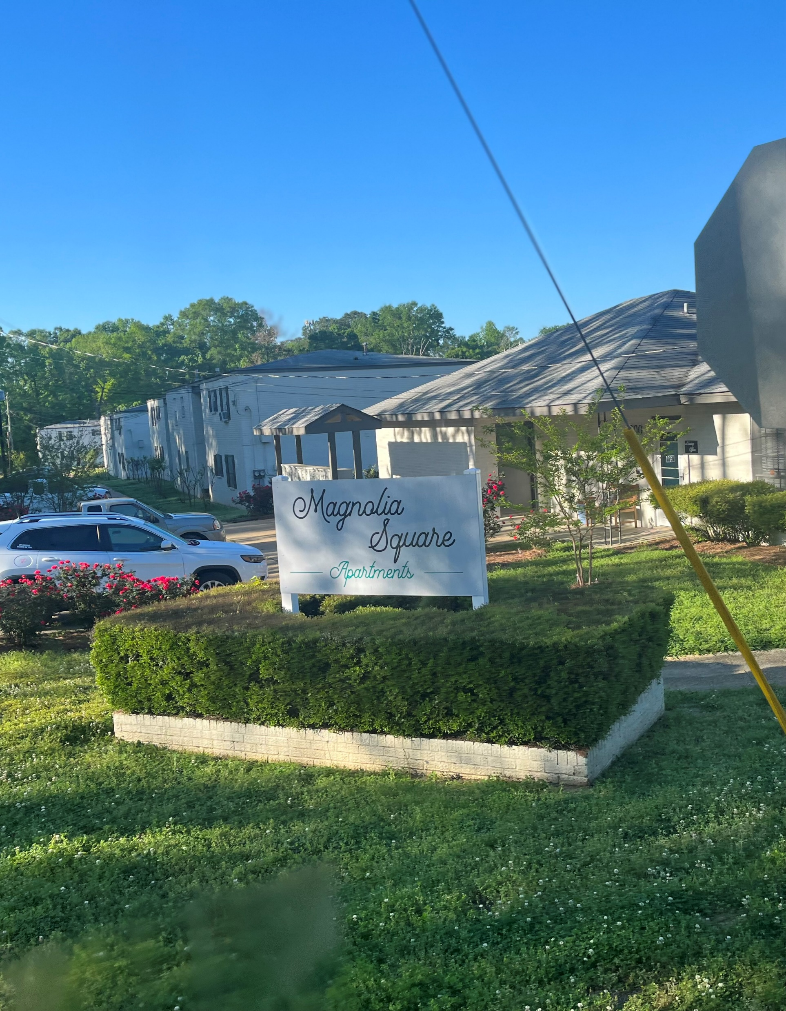
“We Drive, You Ride”

Slide 23
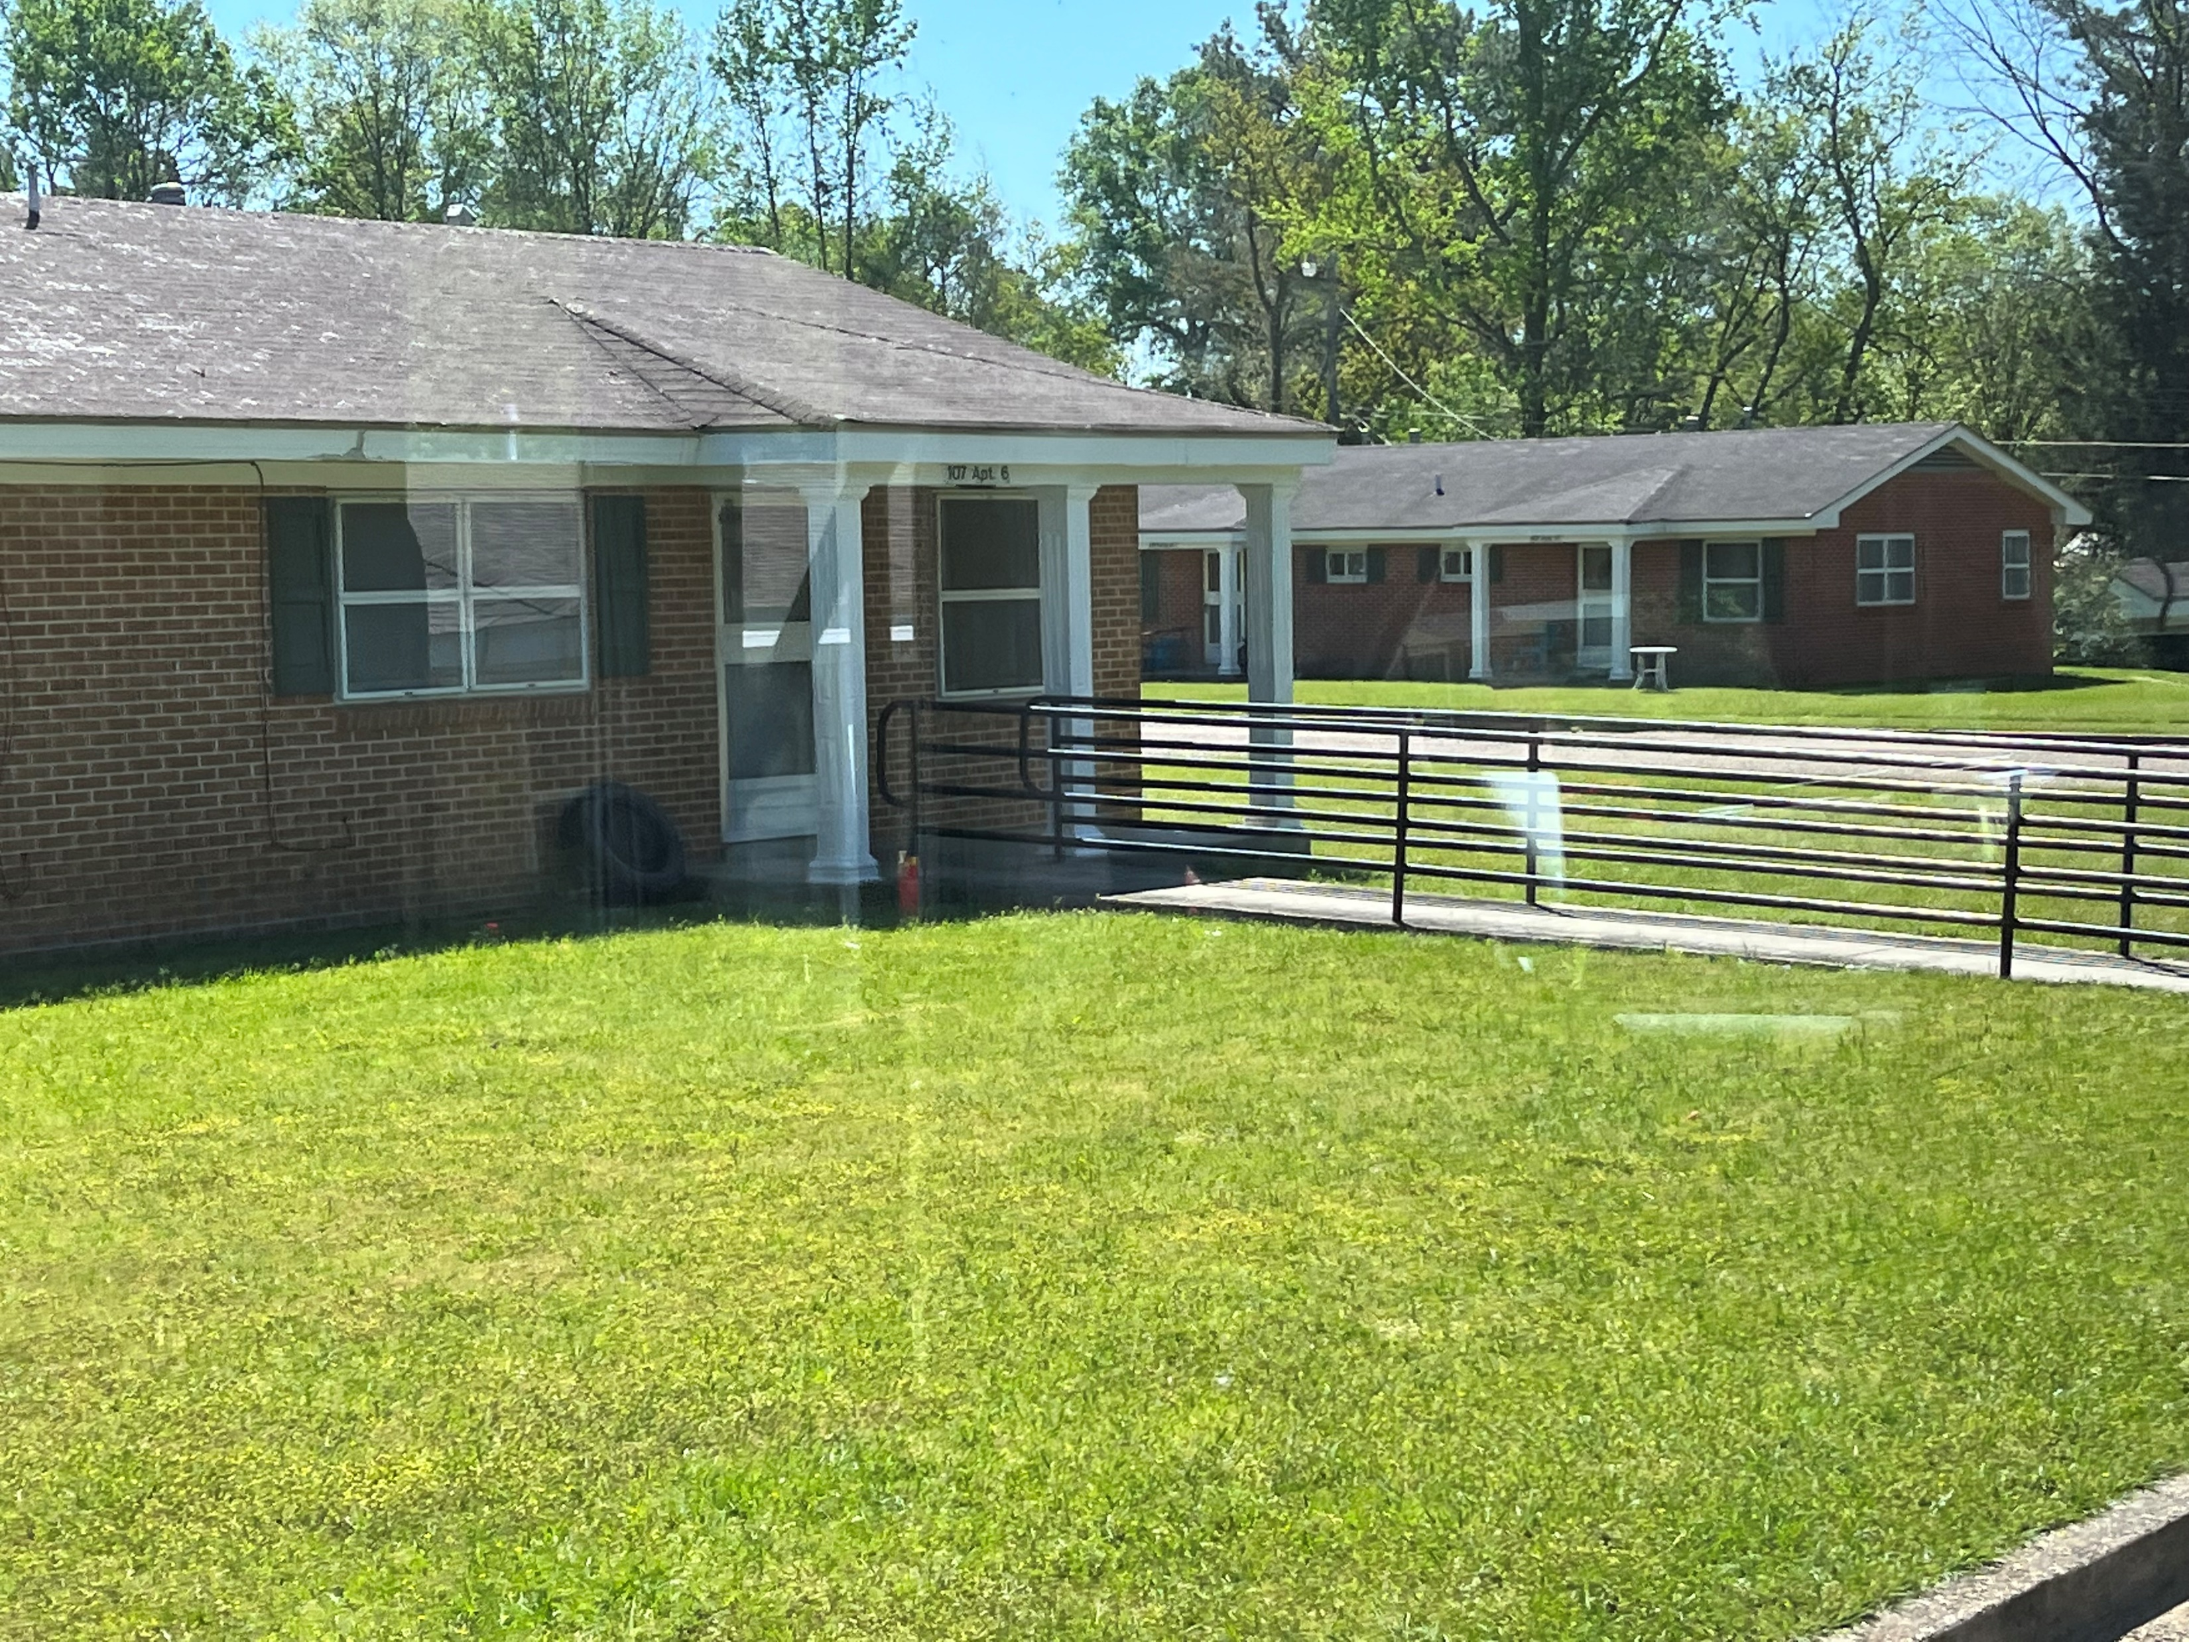
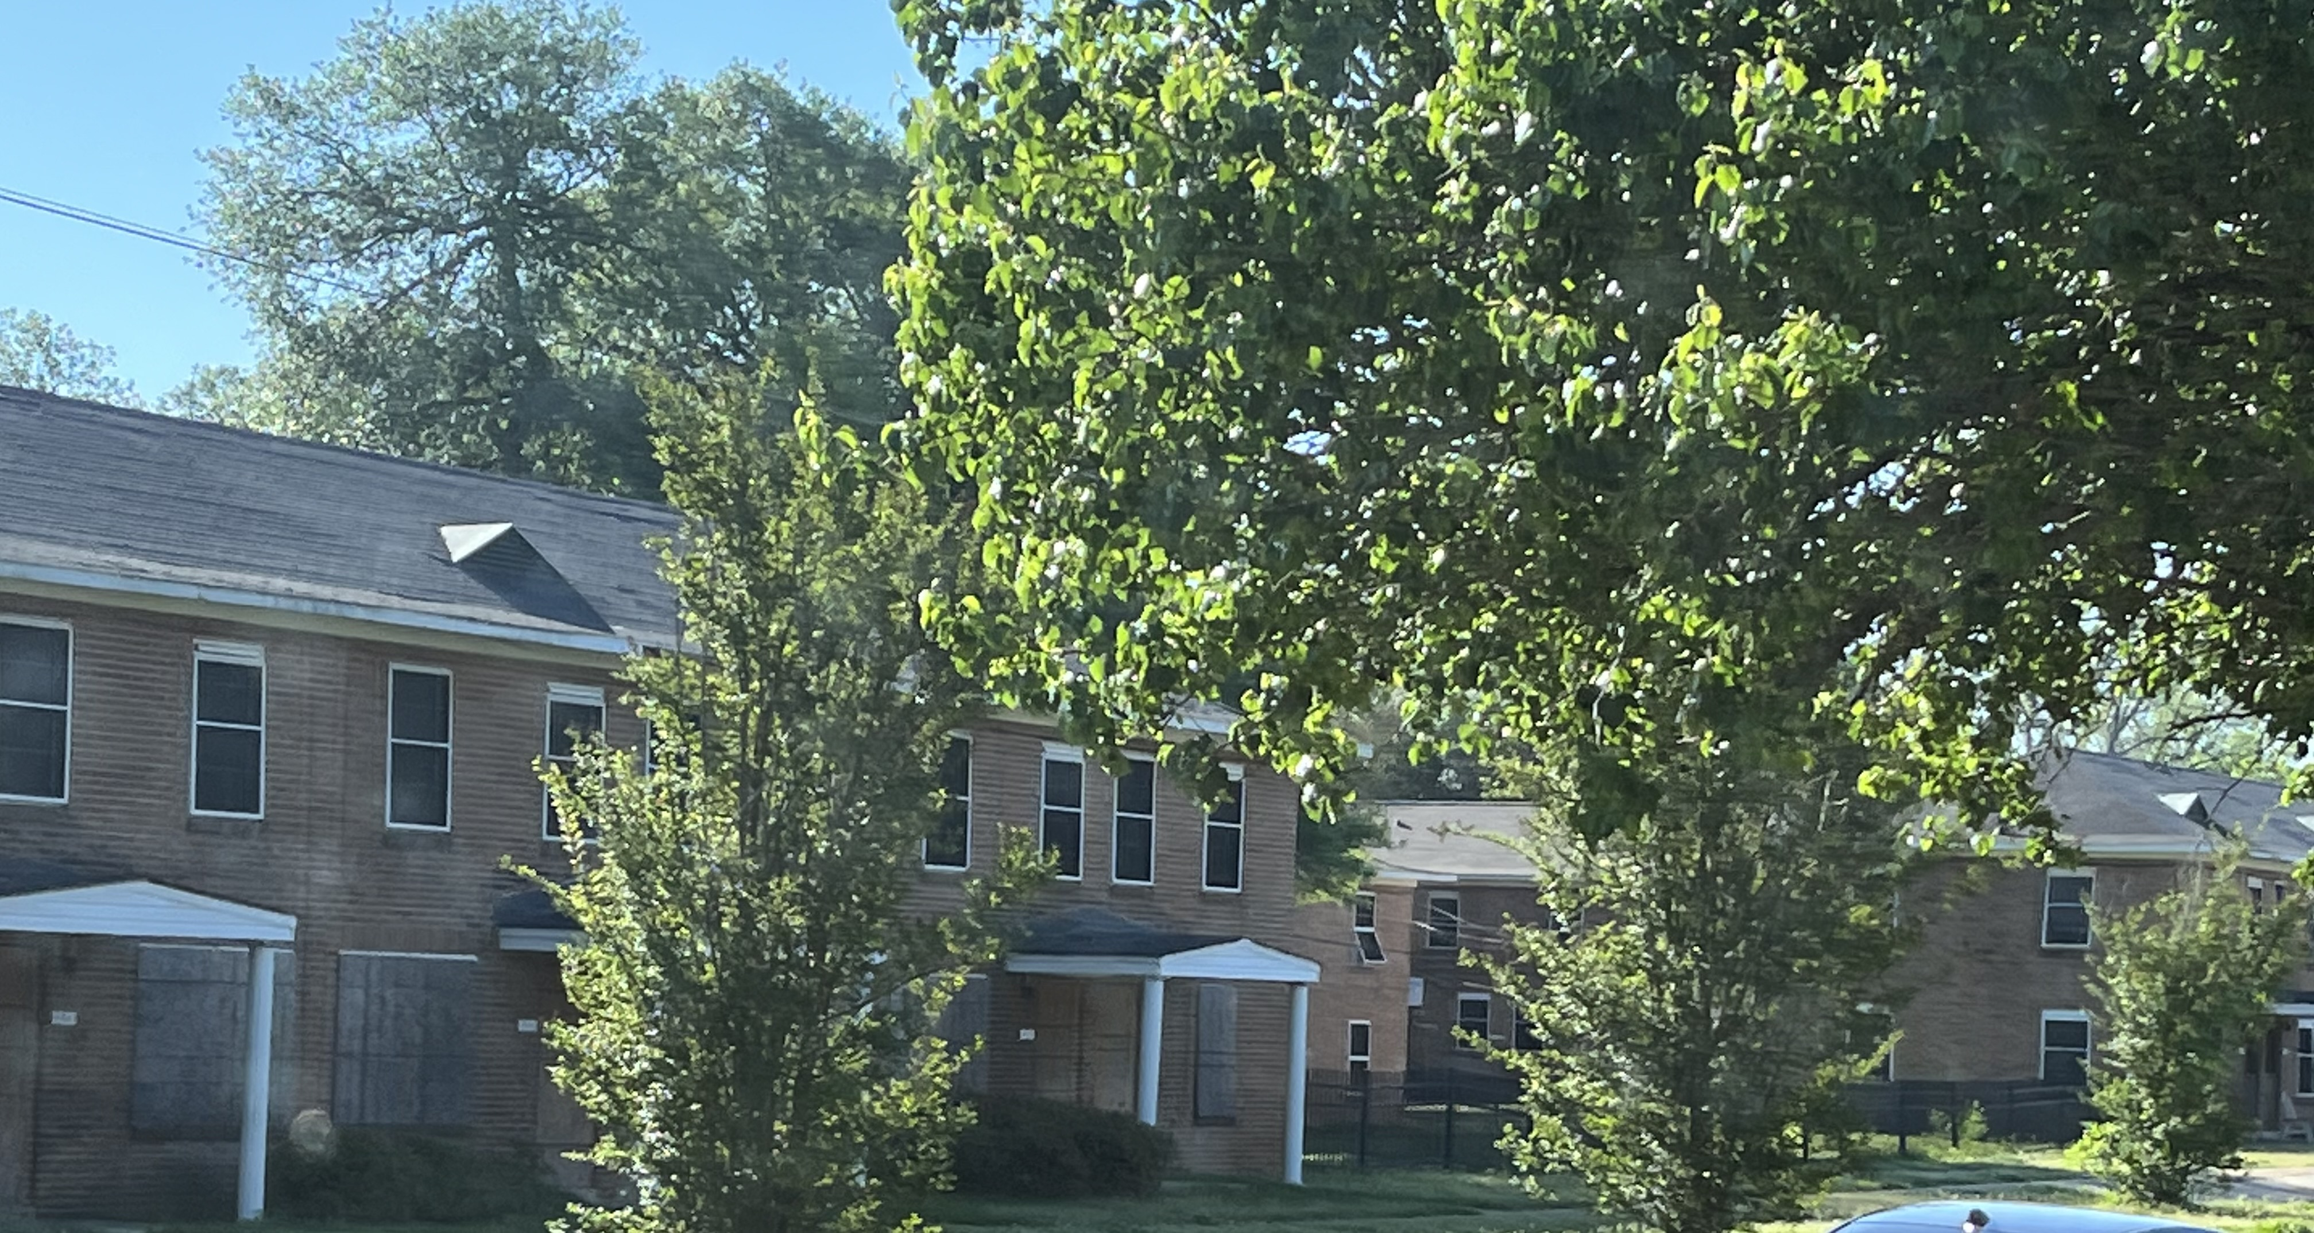
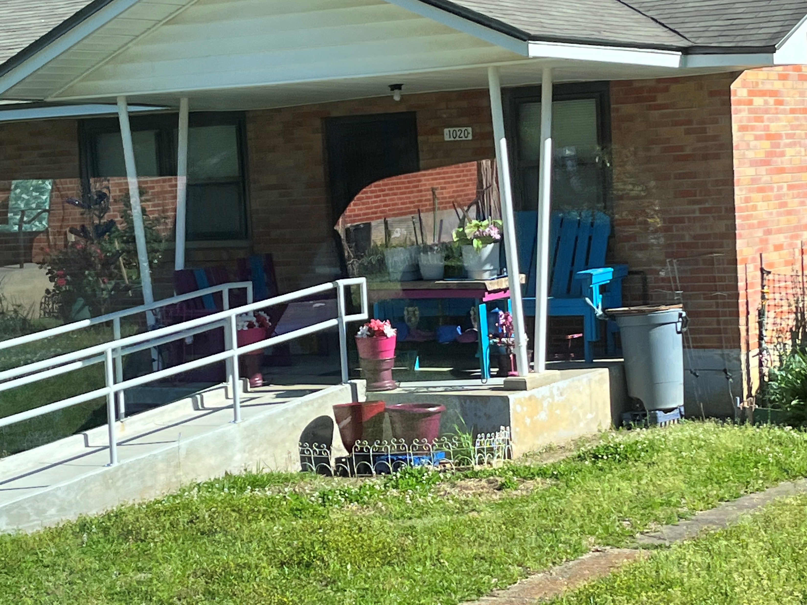
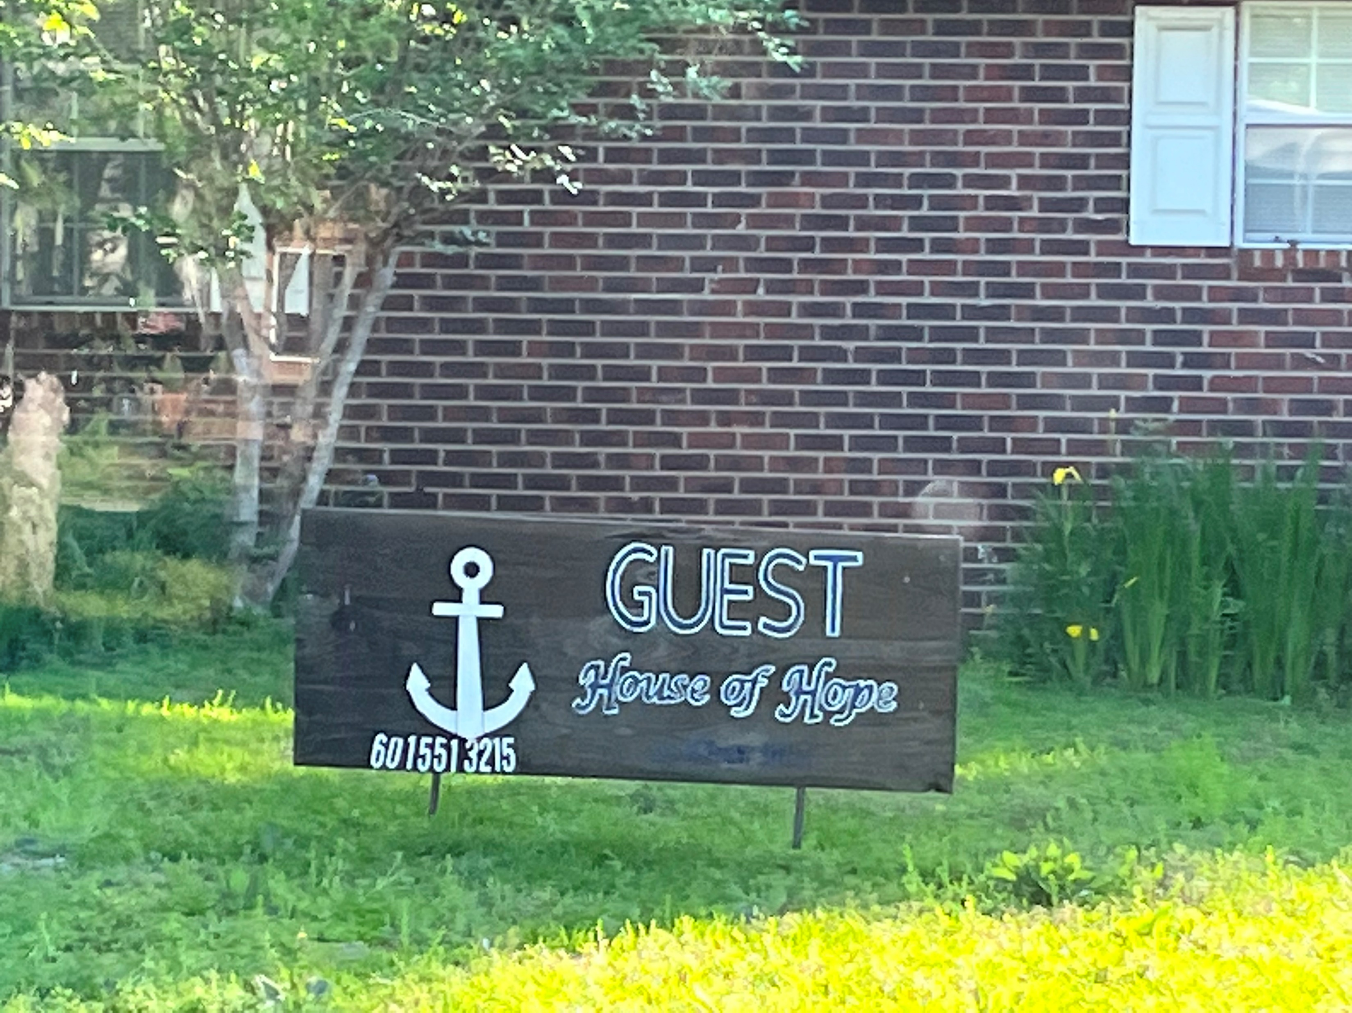
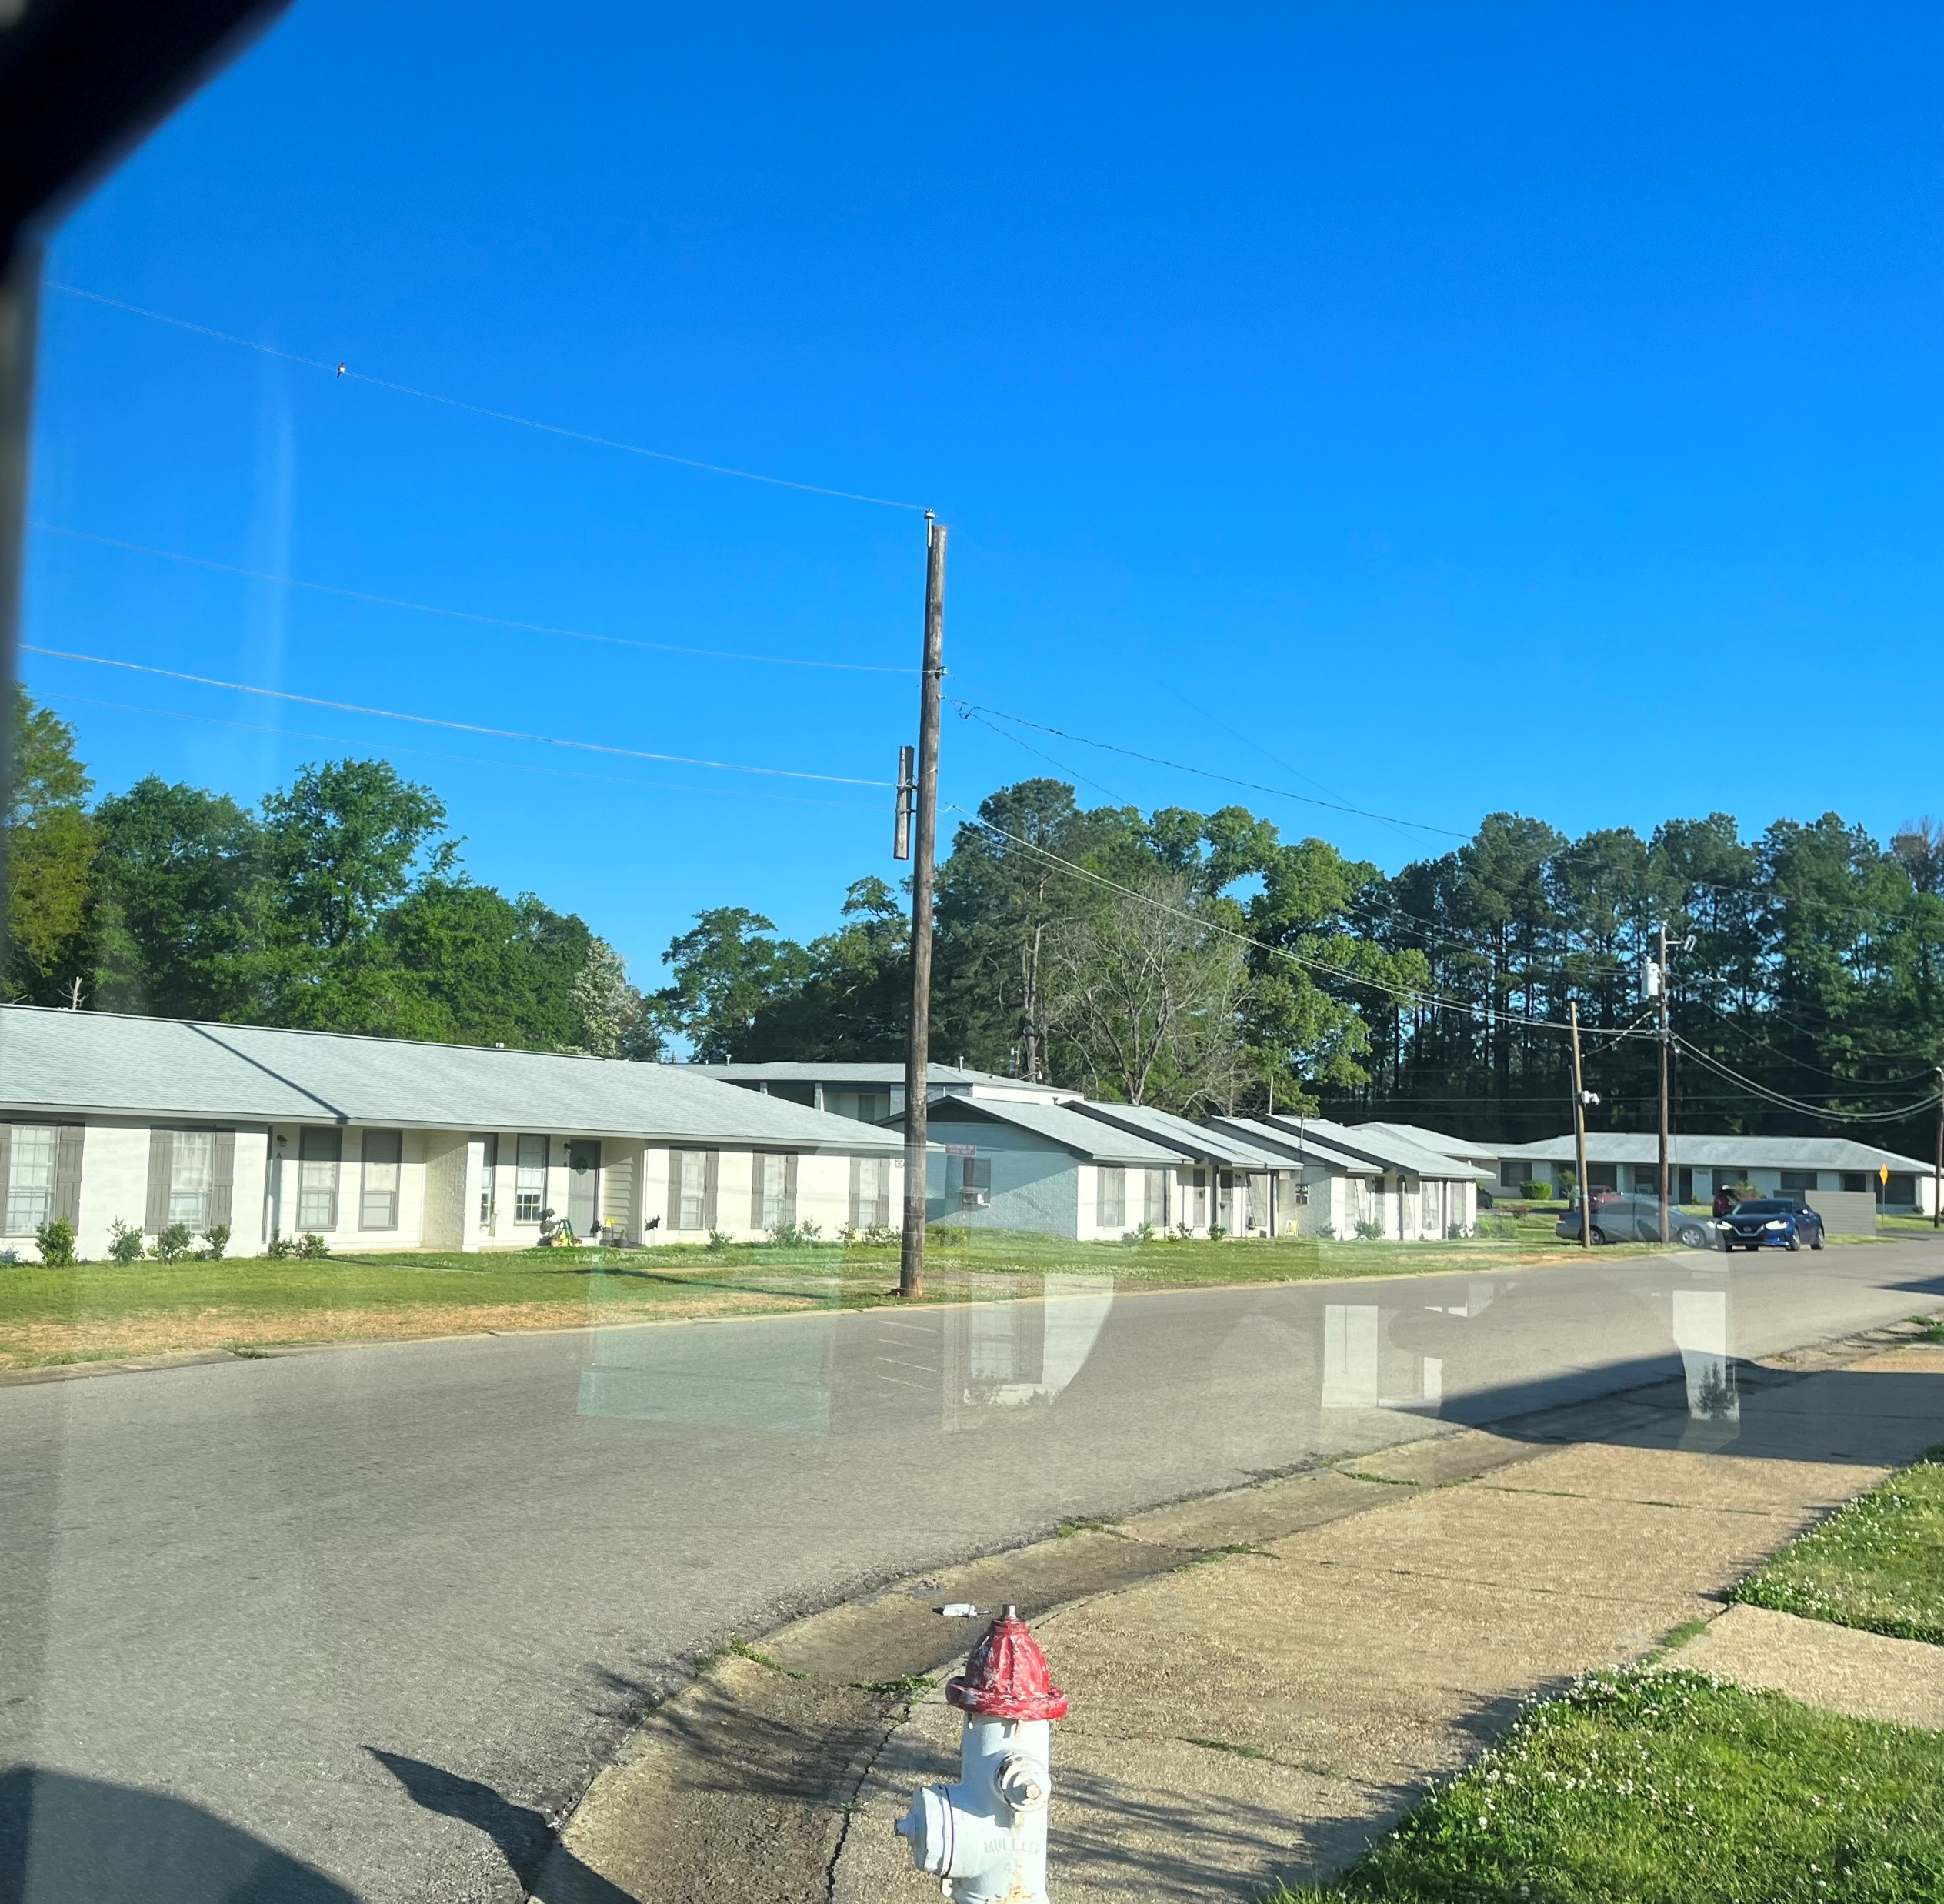
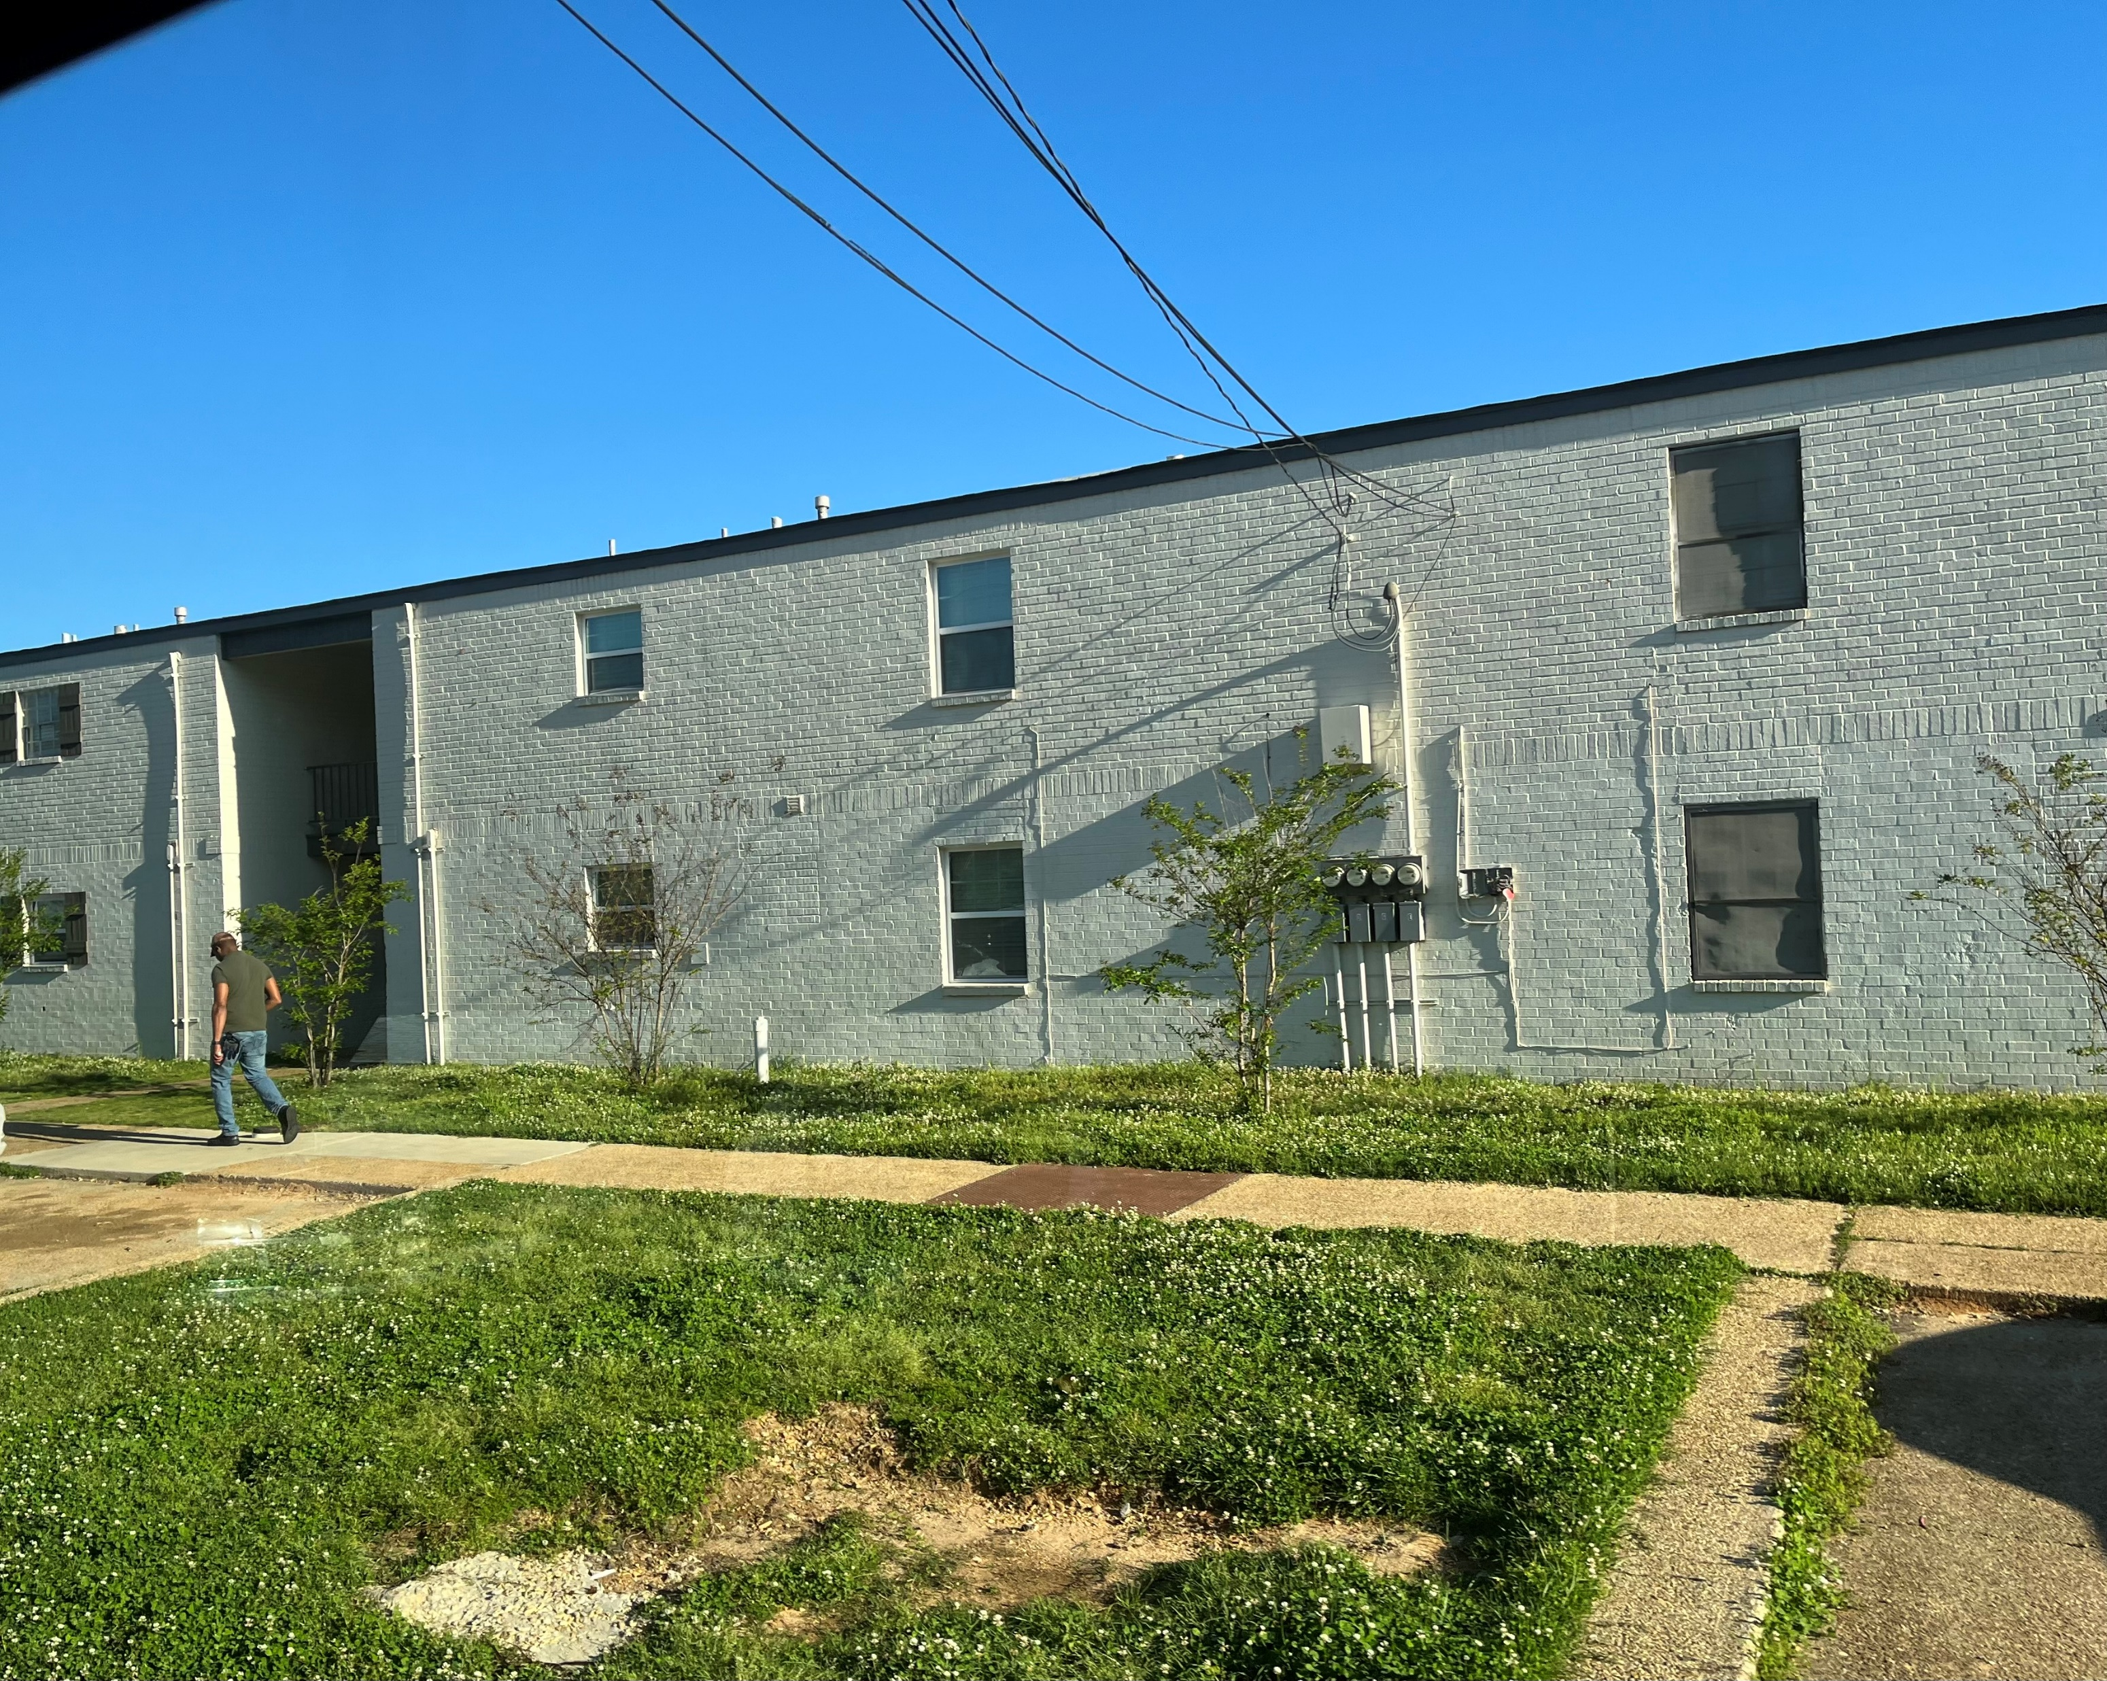

Slide 24
